Slide 1
Use of Technology for better Public Asset Management under Rural Development Government Schemes

Slide 2
Flagship schemes of DoRD- in which technology used
Mahatma Gandhi National Rural Employment Guarantee Act(MG NREGA)
Pradhan Mantri Gram Sadak Yojana(PMGSY)
Pradhan Mantri AwasYojana Gramin(PMAY-G )

Slide 3
Use of Technology in Mahatma Gandhi NREGS
Technology extensively used in Mahatma Gandhi NREGS for :
Planning (GIS based Planning in MGNREGA)
Implementation ( MR through NMMS App, Jaldoot App)
Financial Management (through NeFMS, Payment of Wages through DBT)
Monitoring and Inspections (Area Officer App, usage of drones, GeoMGNREGA)
Data Management (Through NREGASoft Portal)
IEC & Awareness generation (JANMANREGA App)

Slide 4
Geographical Information System (GIS) based Planning in Mahatma Gandhi NREGA
MoRD undertaken implementation of GIS & Remote Sensing (RS) based planning of works since FY 2018-19 .
Systematic development of land, harnessing of rainwater following watershed principles (ridge to valley approach) and creation of income generating assets using (GIS)
Scientific input to the community based participatory planning process at the grass root level.
Targeted GP Plans
2.69 Lakhs
Total Plans Prepared
2.62 Lakhs

Slide 5
GeoMGNREGA
Geotagging of assets created under Mahatma Gandhi NREGS
Phase-I (Geo-tagging of Completed Assets)- All assets completed since inception and started before 31st October 2017.
Phase-II (Geo-tagging in 3 Stages)- Geo-MGNREGA Phase-II . Geo-tagging (of the works initiated post 31st October 2017) is carried out in three stages viz.:
Before initiation of work
During the work and
After completion of work
Total Assets
Total Assets Geotagged
5.33 Crore
5.12 Crore (96%)

Slide 6
Stage-1 (Before)
In this stage, location of the work’s site geotagged before commencement of the work.
Pre conditions:
1. Work should be entered in NREGASoft with TS and AS.
2. DPR(Detail Project Report) should be frozen in NREGASoft.
Out Come
Work’s site (location) geotag with two photographs.

Slide 7
Stage-2(During)
In this stage, on-going status of the work geotagged during progress of the work.
Pre conditions:
1. Stage-1geotag done and received in NREGASoft.
2. 30% of estimated cost booked as expenditure in NREGASoft.
Out-Come:
Geotag of On-going stage of the work with photographs.

Slide 8
Stage-3(After completion of work)
In this stage, assets geotagged after the completion of the work.
Pre conditions:
1. Stage-2 geotagging done and received in NREGASoft.
2. Work marked as completed in NREGASoft.
Out-Come:
Geotag of assets created with photographs.

Slide 9
Use of DRONES in Monitoring
Drones used for regular monitoring as well as special inspection.
Following activities proposed for using drone:
Monitoring of ongoing works
Inspection of completed work
Impact assessment of the completed works
Special inspection
Monitoring quality of assets

Slide 10
Usage of Drone by Ombudsperson
For efficient monitoring and redressal of grievances the Ministry decided that the Ombudsperson may use Drone technology for verification of the works virtually.
On request of Ombudsperson, State to provide service of drone and related required item for viewing the work site livestream at district hqr.
Expenditure on drone service for the Ombudsperson to be booked under administrative head of the scheme at the district level.
Ombudsperson to be provided services within 15 days of the request.

Slide 11
About the Jaldoot in MGNREGA
Ensuring adequate water availability and supply in the rural parts of the country is a National priority
Systematic measurements of the existing depth of groundwater level on a broad basis necessary to improve groundwater level.
MoRD and the MoPR jointly developed “Jaldoot App” for measuring water level.
This enables groundwater monitoring, water budgeting and planning for water harvesting and conservation related works.

Slide 12
Usage of Jaldoot App
Gram Rojgar Sahayak(GRS) employed in Mahatma Gandhi NREGS may be provided with the additional responsibility as ‘Jaldoots’.
In every village, 2-3 open wells need to be selected as samples of the ground water level.
The Jaldoots will enter measurement data of ground water levels through the Jaldoot app twice in a year (pre-monsoon and post-monsoon).
Geo-tagged photographs also needs to be uploaded through the app.
Regular data would be integrated with the database of National Water Informatics Centre (NWIC).
This will be utilised for analysis and display of various useful reports like Water level report, Monsoon Report and Registered user report.

Slide 13
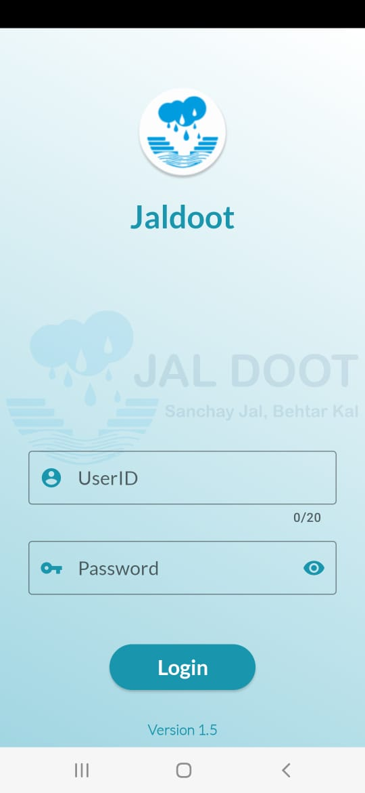
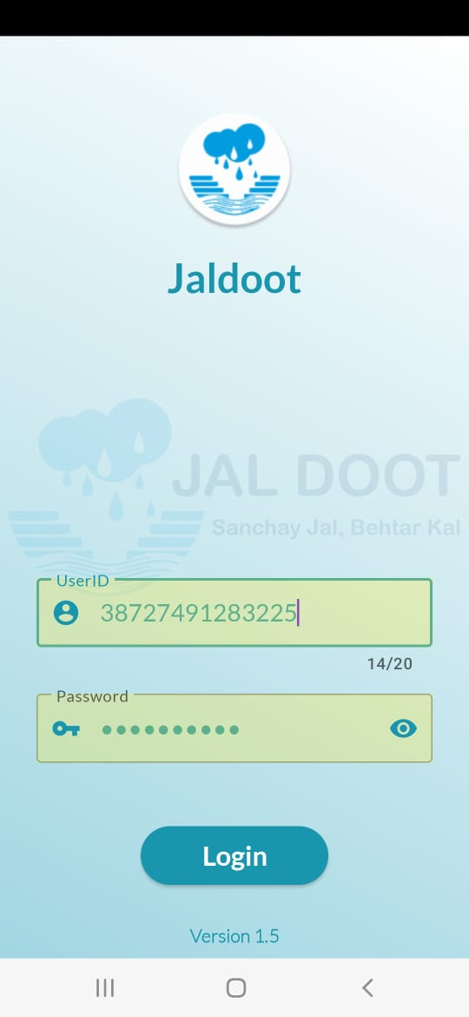
Login Screen
Input your User ID
&
Password

Slide 14
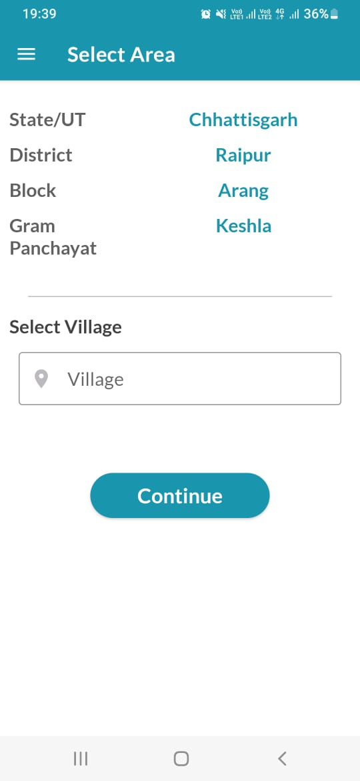
Select your Area
Select your Village

Slide 15
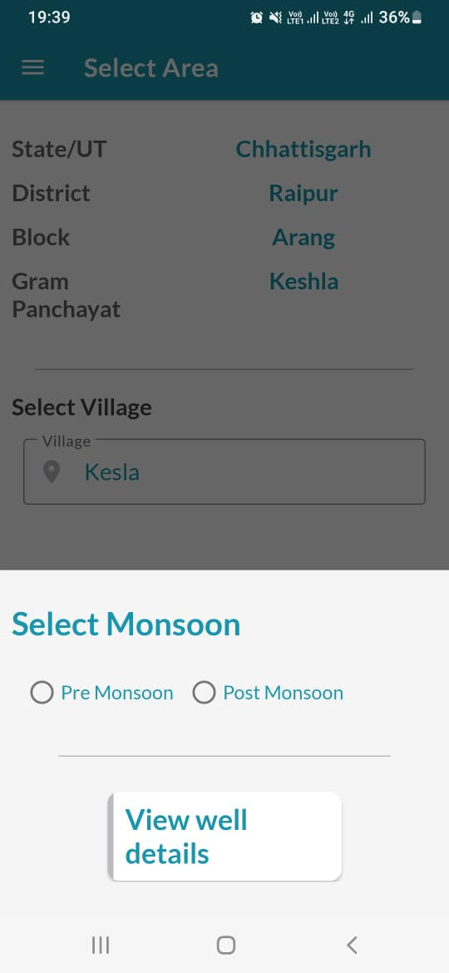
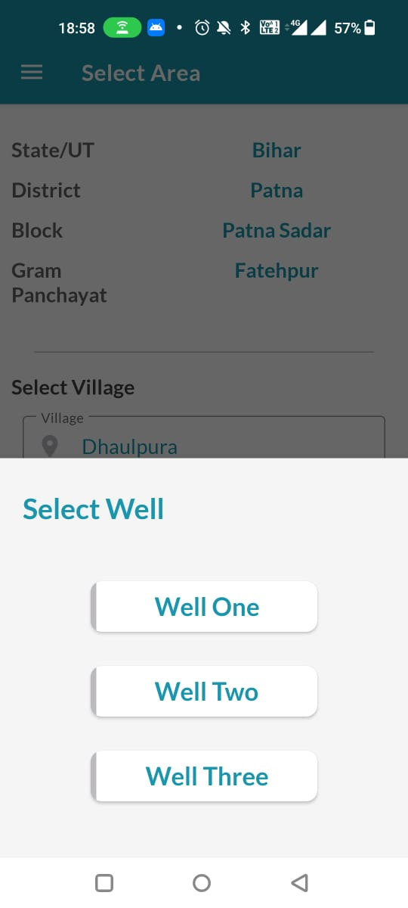
Select Monsoon Type
Select Well

Slide 16
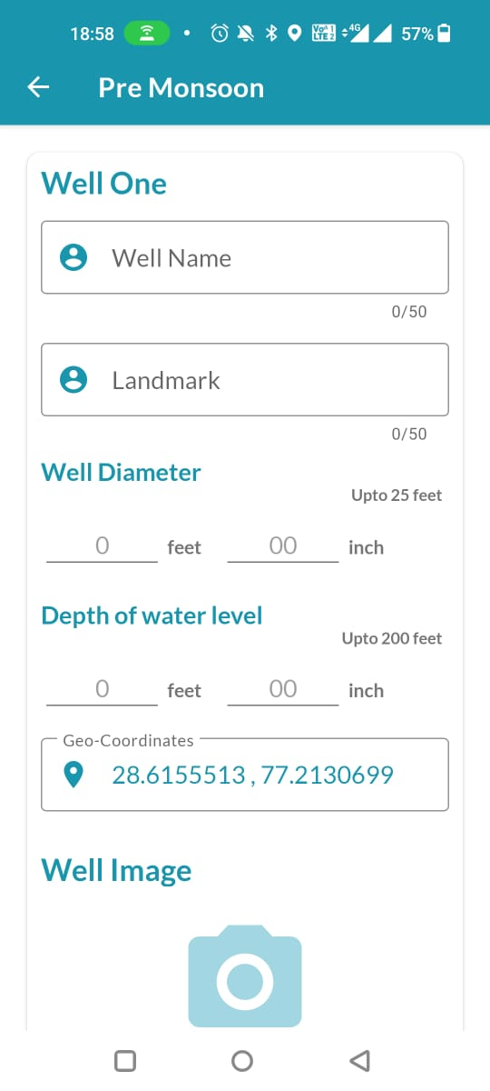
Write down well Name and Landmark
Well details
Fill the Water Level
Latitude and Longitude
by default
Click Photograph of the Well

Slide 17
National Mobile Monitoring System(NMMS) in MGNREGA
Daily attendance of workers along with 1st Photograph taken by App at any time by the field functionaries (online & offline), 4 hours gap to be maintained strictly between 1st & 2nd Photograph.
Uploading of attendance to be done till 11:59:59 PM on the same day.
App available in Google Play Store for downloading
NMMS Status - August 2023 (2nd Fortnight)
Eligible Works | MR filled through NMMS | Eligible Works | MR filled through NMMS
373221 | 342213 (91.69%) | 131464 | 84410 (64.20%)

Slide 18
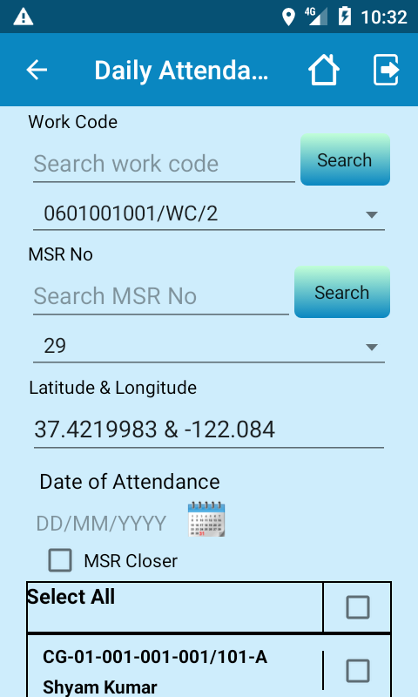
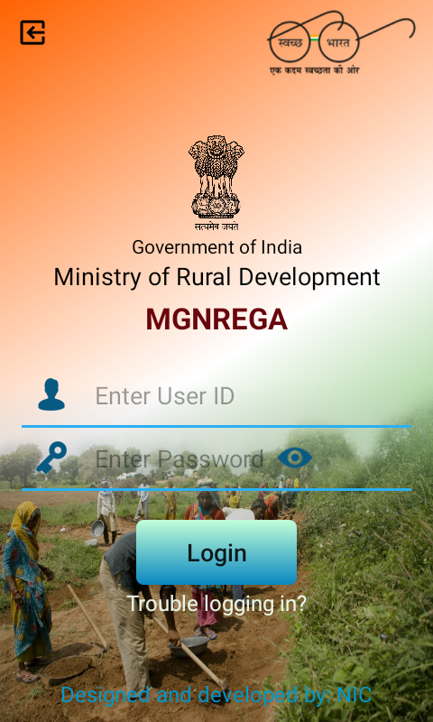
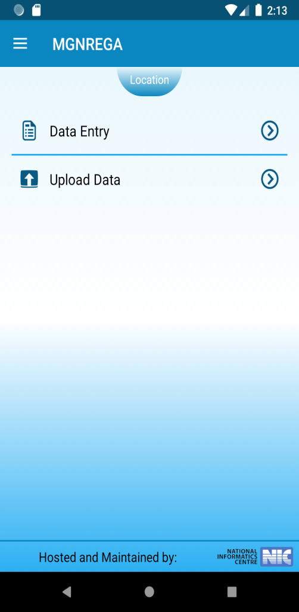
NMMS APP

Slide 19
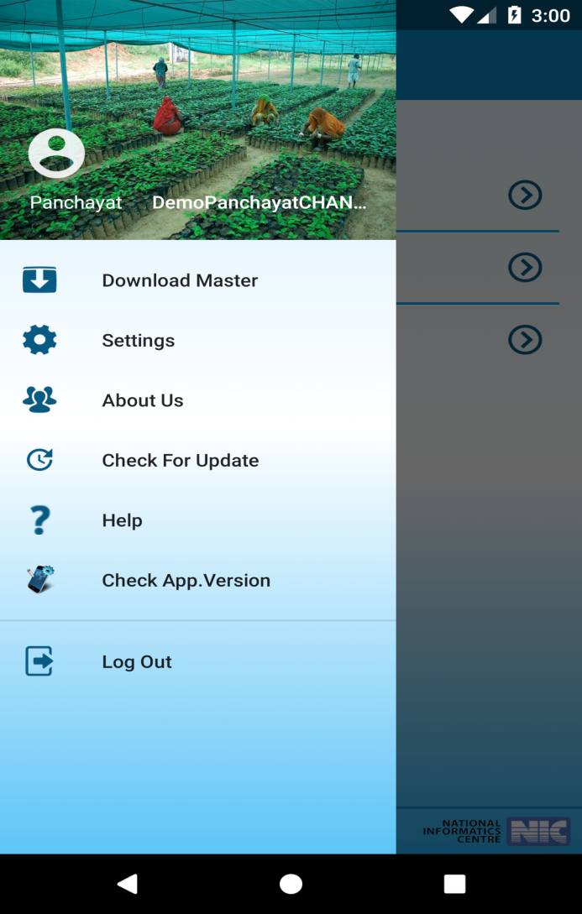
Other activities

Slide 20
Citizen-Centric Mobile Application (CCMA)
An instrument for information flow from ground level to the highest level and is a bridge between citizens and the system.
Supports policy decisions at the Ministry to improve quality of public services.
Citizen will able to provide feedback about assets that have been created.
An initiative towards - Transparency, Accountability and Good Governance
Total No of Janmanrega users across India - 1,29,331
About JANMANREGA

Slide 21
Area Officer App in MGNREGA
Area Officer App created to ensure real-time inspection of RD schemes and monitor progress through evidence-based reporting.
Target Users :
Admin level: GOI Officers (Central Users), State Govt. Officers
Mobile Users: Central Officers, State Officers, District Officers, Block Officers
respective senior officials
Total worksites inspected by State-District-Block-GP Level officials
List of works is proposed to be populated in the App in accordance with the deviations observed in the various parameters of implementation of the scheme

Slide 22
Area Officer Visit APP –Features
App developed for Area officers to record the finding during the visit
It can be installed only on registered mobile numbers of Area officers
Developed for Mahatma Gandhi NREGA, PMAYG, PMGSY, NSAP, DAY NRLM, SPM RURBAN, DDUGKY and Mission Antodaya
One Photograph (with time stamp and geo-coordinate) to be taken for each level (State/District/GP/Worksite)

Slide 23
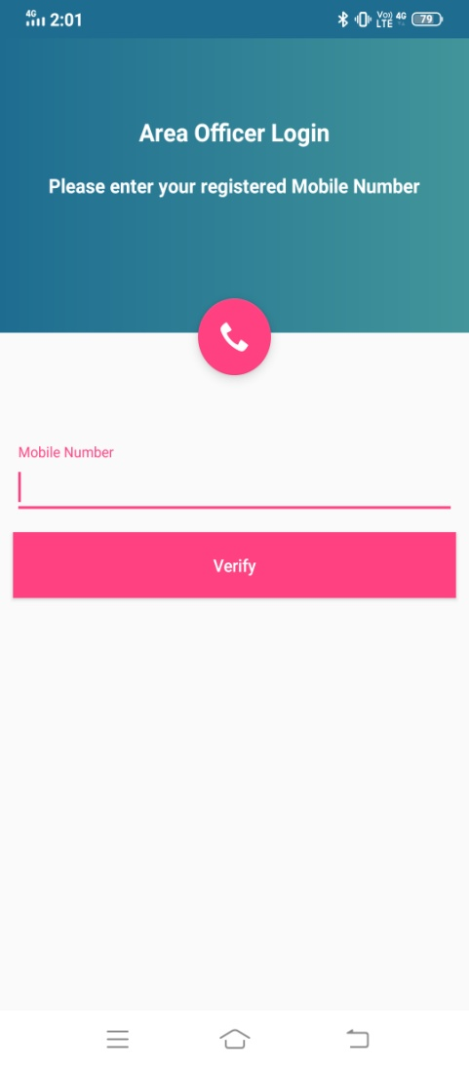
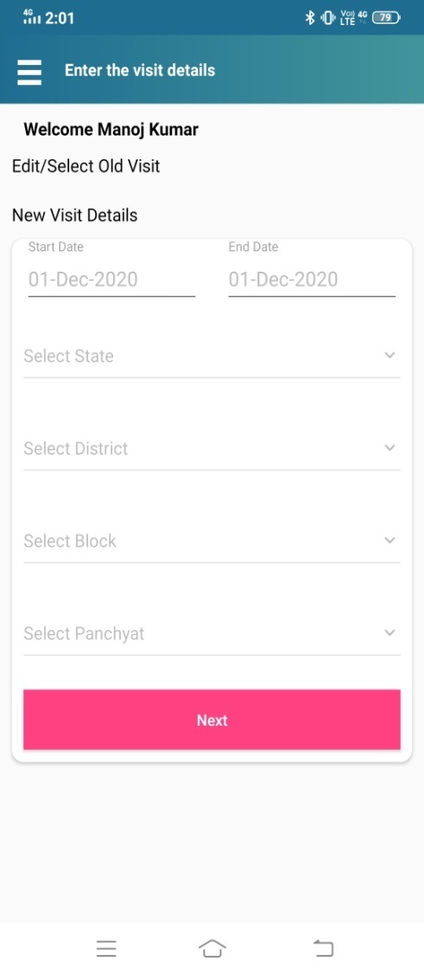
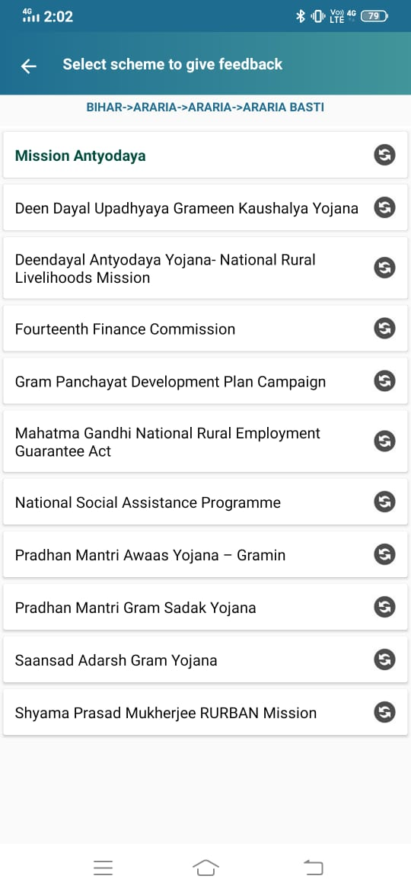
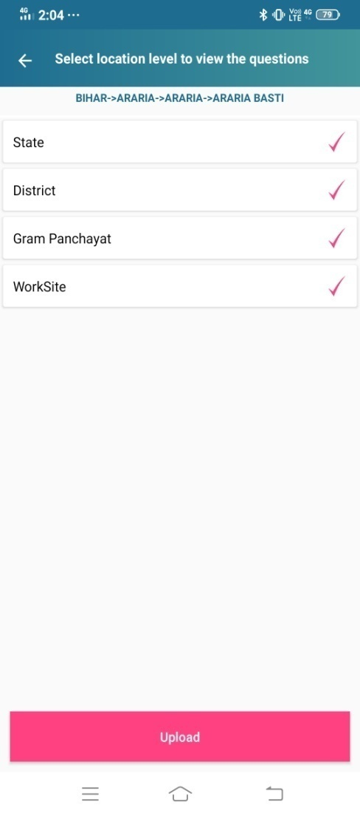
Login and selection of Schemes

Slide 24
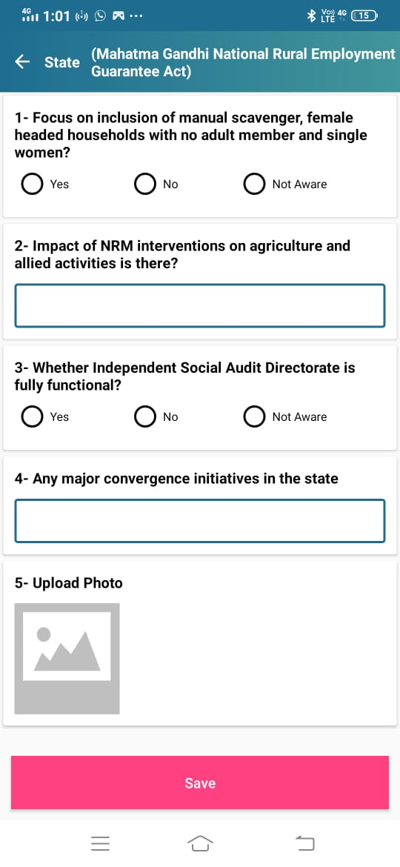
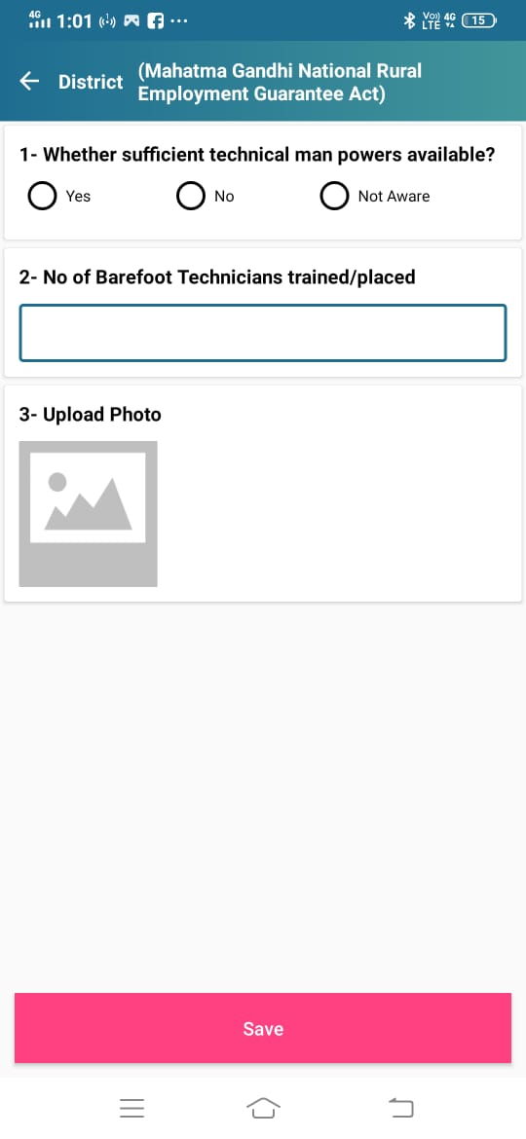
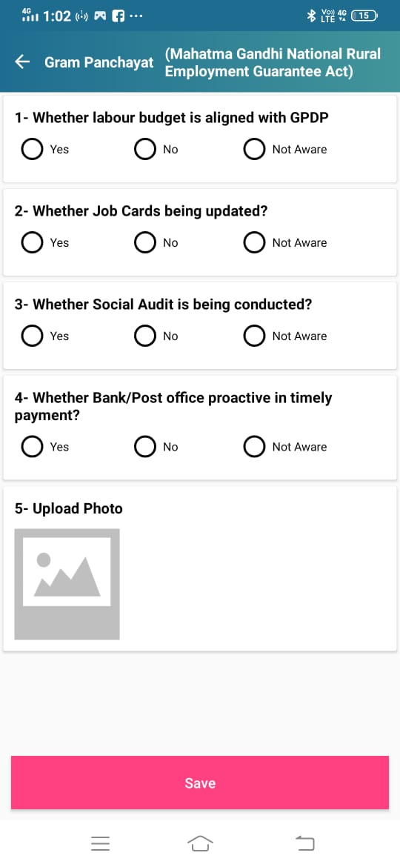
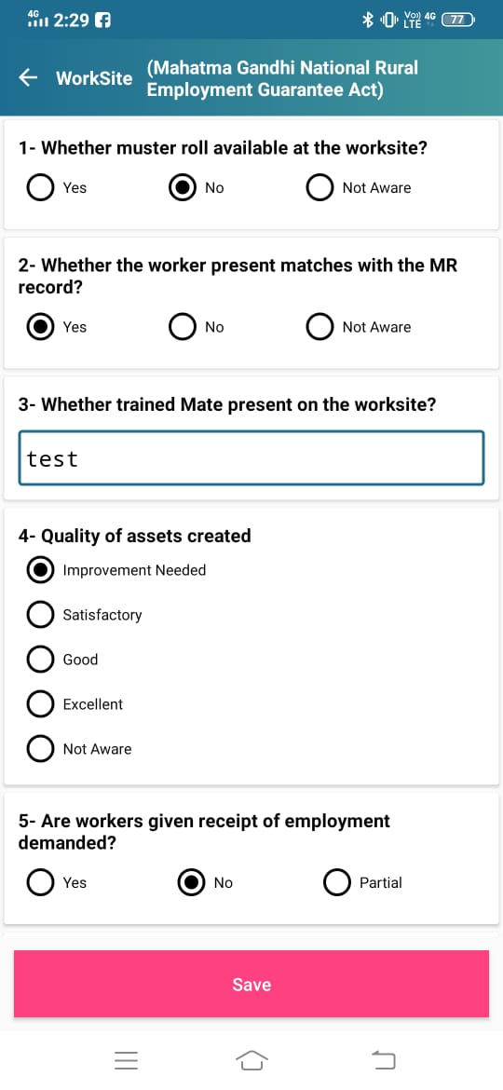
MGNREGA-Questions
State
District
Gram panchayat
Worksite
There are 5 questions for state for MGNREGA scheme and an option to upload a photo.

Slide 25
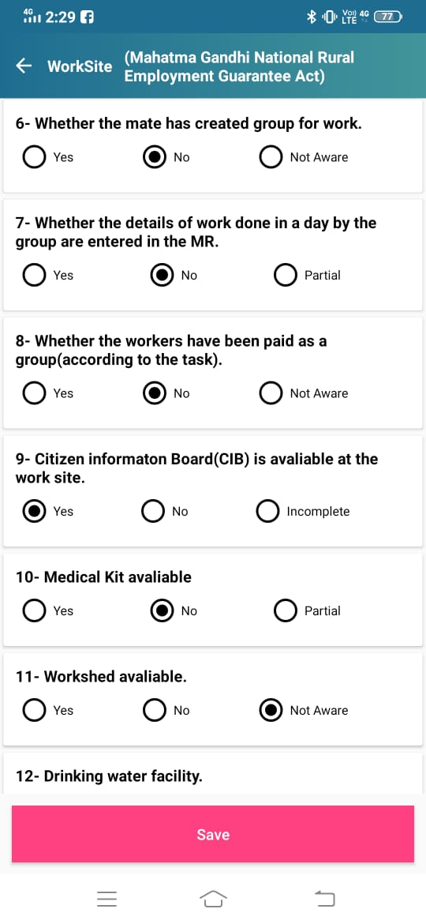
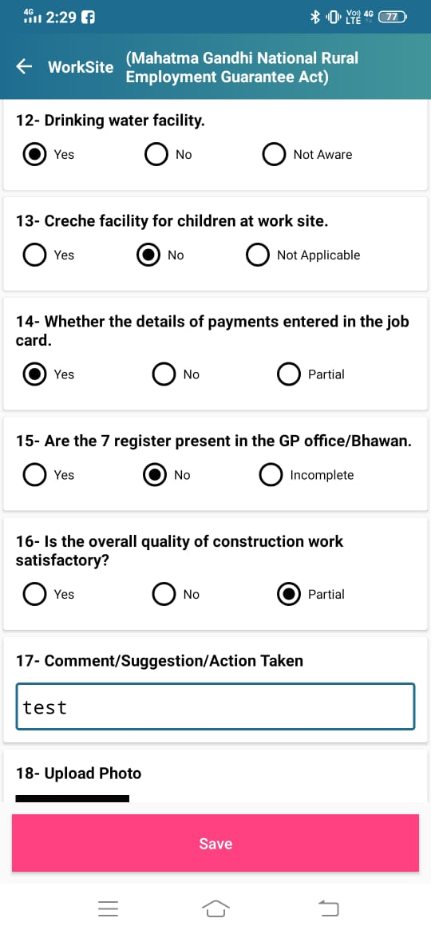
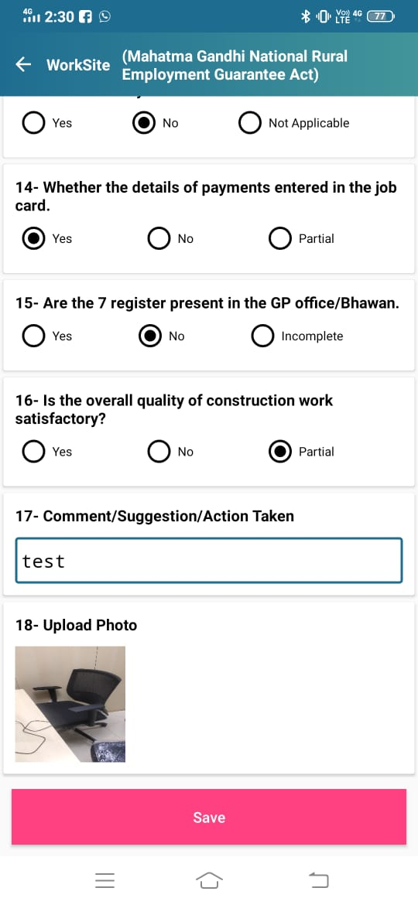
MGNREGA Worksite Questions –Contd.
Successfully
Saved in database

Slide 26
Use of Technology in PMGSY
In Pradhan Mantri Gram Sadak Yojana (PMGSY), Technology used for the following purposes:
Financial Management &Payments (through NeFMS and DBT)
Quality Control (Availability of Quality Control Registers online)
Innovations (Full Depth Reclamation (FDR) Technology, Fast construction through Green Technology )

Slide 27
Use of Technology in Pradhan Mantri Awas Yojana-Gramin ( PMAY-G)
Technology plays an important role in PMAY for the following:
Implementation (Housing Design Typology)
Monitoring (Geo-Spatial Technology)

Slide 28
THANK YOU

